Slide 1
COMP 3500 Introduction to Operating Systems TLB and Memory Accesses
Dr. Xiao Qin
Auburn University http://www.eng.auburn.edu/~xqin
xqin@auburn.edu
Notes:
Fall’17:
backingstore_reader.c 3 minutes
Main function of project 5: 10 minutes
Slides: 10-20. 40 minutes.
Fall’16: 35 Minutes: slides 1-10
Fall’16: 13c Cont. to be covered in 14b. Slides 11-21
Fall’15: 35 Minutes: slides 1-11
Lec14a-14c: Project 5 from design to implementation.
Cont to Lec16a

Slide 2
Source Code: backingstore_reader.c

Slide 3
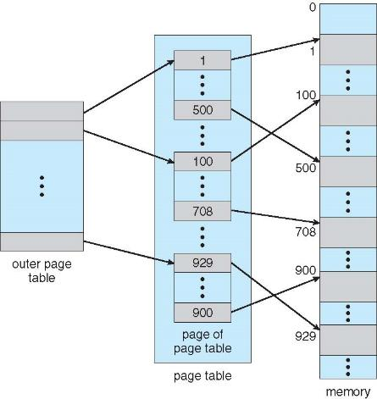
Review: Two-Level Page-Table Scheme

Slide 4
Why two-level page-table scheme?
Exercise 1 (Plickers): We assume that page size is 4KB (i.e., 2¹²), each page table entry is 4 bytes. How large is the page table for a 32-bit logical address space?
A. 1 MB B. 2 MB C. 4 MB D. 8 MB
1 million page table entries (2³² / 2¹² = 2²⁰ = 1 M)
If each entry is 4 bytes -> 4 MB of physical address space / memory for page table alone
4 MB cost a lot 20 years ago.
Notes:
Memory structures for paging can get huge using straight-forward methods
Consider a 32-bit logical address space as on modern computers
Page size of 4 KB (2¹²)
Page table would have 1 million entries (2³² / 2¹²)
If each entry is 4 bytes -> 4 MB of physical address space / memory for page table alone
That amount of memory used to cost a lot
Don’t want to allocate that contiguously in main memory
Hierarchical Paging
Hashed Page Tables
Inverted Page Tables

Slide 5
Exercise 2 (Plickers): We assume that page size is 1KB (i.e., 2¹⁰), each page table entry is 8 bytes. How large is the page table for a 64-bit logical address space?
A. 2⁵⁴ Bytes B. 2⁵⁵ Bytes C. 2⁵⁶ Bytes D. 2⁵⁷ Bytes
Page table entries (2⁶⁴ / 2¹⁰ = 2⁵⁴)
2⁵⁴ entries * 8 B/entry = 2⁵⁷ B
Notes:
Memory structures for paging can get huge using straight-forward methods
Consider a 32-bit logical address space as on modern computers
Page size of 4 KB (2¹²)
Page table would have 1 million entries (2³² / 2¹²)
If each entry is 4 bytes -> 4 MB of physical address space / memory for page table alone
That amount of memory used to cost a lot
Don’t want to allocate that contiguously in main memory
Hierarchical Paging
Hashed Page Tables
Inverted Page Tables

Slide 6
Hierarchical Page Tables
Break up the logical address space into multiple page tables
A simple technique is a two-level page table
Keep level-2 page tables in a hard disk.

Slide 7
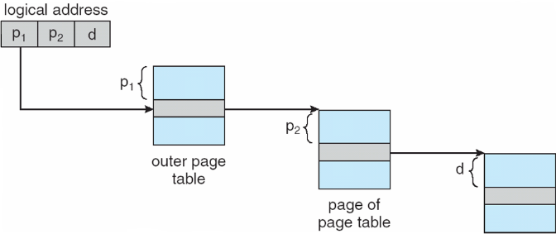
Address-Translation in a Two-level Paying Scheme
Basic Idea: Page the page tables

Slide 8
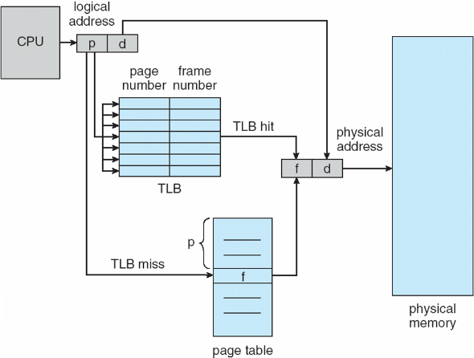
Exercise 3 (Plickers): Paging Hardware with Translation Look-aside Buffers (TLB)
Why TLBs are typically small (64 to 1,024 entries)?
Program is small
Cost is high
Address space is small
Performance is high

Slide 9
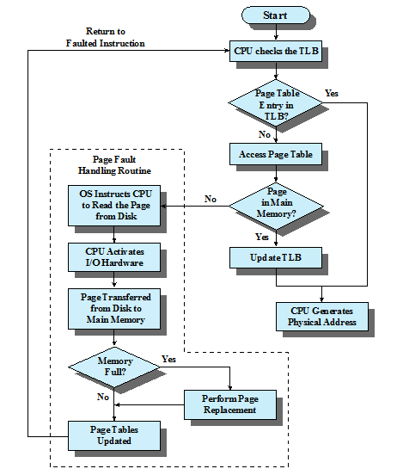
Paging and Translation Lookaside Buffer (TLB)

Slide 10
Parallel Searching the TLB
How to search TLB?
Associative memory: parallel search
Address translation (p, d)
If p is in associative register, get frame # out
Otherwise get frame # from page table in memory

Slide 11
Address Space ID in TLBs
Exercise 4 (Plickers): Why some TLBs store address-space identifiers (ASIDs) in each TLB entry – uniquely identifies each process?
High performance
Low cost
Security protection
High scalability
To provide address-space protection for that process

Slide 12
Exercise 5 (Plickers): What happens on a TLB miss?
A. There will never be a TLB miss
B. Replace an existing TLB entry
C. Schedule the entries in TLB
D. There will be a page table miss
Value (?) is loaded into the TLB for faster access next time
Replacement policies must
be considered
Notes:
Review
Hierarchical Page Tables
Translation Look-aside Buffers (TLBs)
New Topic:
Effective Memory Access Time
What value? (page#, frame#) in the page table.
Replacement policies must be considered
Some entries can be wired down for permanent fast access

Slide 13
Effective Memory Access Time
Associative Lookup = Ttlb time unit
TLB hit ratio = h
percentage of times that a page number is found in the associative registers;
T_{hit} = T_{tlb} + T_{mem}
T_{miss} = T_{tlb} + T_{mem} + T_{tlb_update} + T_{mem}
access page table
access data
T_{miss} = T_{tlb} + T_{mem} + T_{mem}
Effective Access Time = h*T_{hit} + (1-h)*T_{miss}
Notes:
TLB update and accessing data in memory are performed in parallel
T_tlb_update << T_mem
Associative Lookup = Ttlb time unit
Can be < 10% of memory access time
Hit ratio = h
Hit ratio – percentage of times that a page number is found in the associative registers; ratio related to number of associative registers

Slide 14
Exercise 6: Effective Access Time
Consider a single-level paging scheme. The TLB has 32 entries. The TLB access time is 10 ns; memory access time is 200ns.
How long does it take to access data in memory if there is a TLB hit?
How long does it take to access data in memory if there is a TLB miss?
What is the effective memory-access time if we have a TLB hit ratio of 80%?
What is the minimal hit ratio that guarantees the effective access time of at most 220ns?

Slide 15
Memory Protection
Associate protection bit with each frame to indicate if read-only or read-write access is allowed
Exercise 7: How can we indicate a page is execute-only or not?
Add one more bit!
Notes:
Memory protection implemented by associating protection bit with each frame to indicate if read-only or read-write access is allowed
Answer: more bits to indicate page execute-only, and so on
Valid-invalid bit attached to each entry in the page table:
“valid” indicates that the associated page is in the process’ logical address space, and is thus a legal page
“invalid” indicates that the page is not in the process’ logical address space
Or use page-table length register (PTLR)
Any violations result in a trap to the kernel

Slide 16
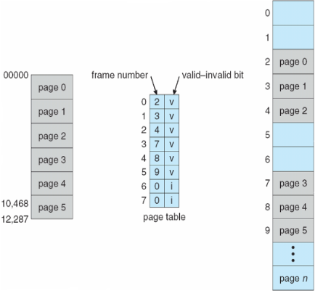
Memory Protection: Valid-invalid bit
Valid-invalid bit attached to each entry in the page table:
“valid” indicates that the associated page is in the process’ logical address space, and is thus a legal page
“invalid” indicates that the page is not in the process’ logical address space
Or use page-table length register (PTLR)
Any violations result in a trap to the kernel
Notes:
Memory protection implemented by associating protection bit with each frame to indicate if read-only or read-write access is allowed
Answer: more bits to indicate page execute-only, and so on
Valid-invalid bit attached to each entry in the page table:
“valid” indicates that the associated page is in the process’ logical address space, and is thus a legal page
“invalid” indicates that the page is not in the process’ logical address space
Or use page-table length register (PTLR)
Any violations result in a trap to the kernel

Slide 17
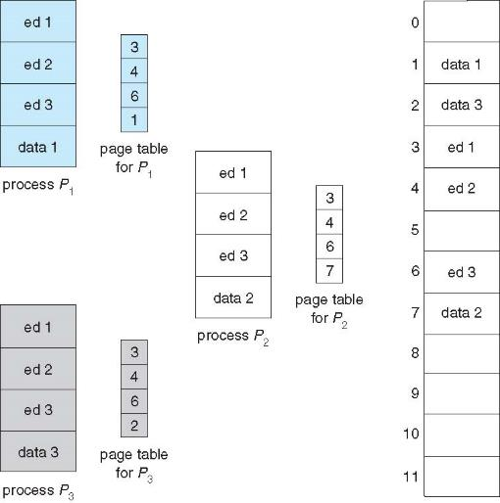
Exercise 8: What do you observe from the following three page tables?
Shared Pages
Shared code: one copy of read-only (reentrant) code shared among processes
Private code and data: Each process keeps a separate copy of the code and data
Notes:
Shared code
One copy of read-only (reentrant) code shared among processes (i.e., text editors, compilers, window systems)
Similar to multiple threads sharing the same process space
Also useful for interprocess communication if sharing of read-write pages is allowed
Private code and data
Each process keeps a separate copy of the code and data
The pages for the private code and data can appear anywhere in the logical address space

Slide 18
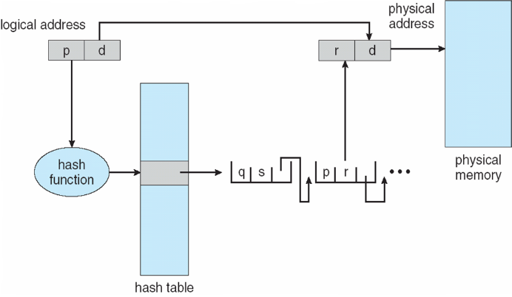
Hashed Page Table
The virtual page number is hashed into a page table
Exercise 5: What happens if two page numbers are hashed to the same location?
Notes:
Common in address spaces > 32 bits
The virtual page number is hashed into a page table
Answer Q7: This page table contains a chain of elements hashing to the same location
Each element contains (1) the virtual page number (2) the value of the mapped page frame (3) a pointer to the next element
Virtual page numbers are compared in this chain searching for a match
If a match is found, the corresponding physical frame is extracted
Variation for 64-bit addresses is clustered page tables
Similar to hashed but each entry refers to several pages (such as 16) rather than 1
Especially useful for sparse address spaces (where memory references are non-contiguous and scattered)

Slide 19
Clustered Page Tables
Similar to hashed page tables
Each entry refers to several pages (such as 16) rather than 1
Especially useful for sparse address spaces (where memory references are non-contiguous and scattered)

Slide 20
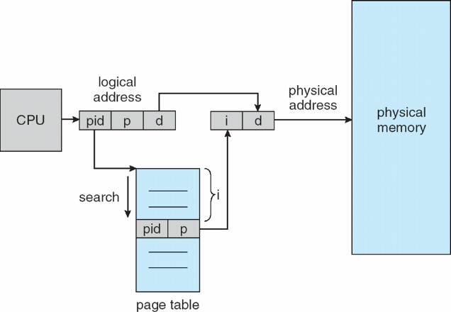
Inverted Page Table Architecture
Track all physical pages
One entry for each frame in physical memory
Entry: pid + page#
Pros: Decreases memory needed to store each page table
Cons: increases time needed to search the table
Exercise 6: How to improve performance of the inverted page table?
TLB
Use a hash table
Notes:
Rather than each process having a page table and keeping track of all possible logical pages, track all physical pages
One entry for each real page of memory
Entry consists of the virtual address of the page stored in that real memory location, with information about the process that owns that page
Decreases memory needed to store each page table, but increases time needed to search the table when a page reference occurs
Use hash table to limit the search to one — or at most a few — page-table entries
TLB can accelerate access
But how to implement shared memory?
One mapping of a virtual address to the shared physical address

Slide 21
Summary
Hierarchical Page Tables
Translation Look-aside Buffers (TLBs)
Effective Memory Access Time
Hashed Page Table
Inverted Page Table

